Slide 1


FlyinTravel
Ganesh Santhar
BhanuPrakash Ramineni
Jithin James
Rambabu Kunchala
Rakhi Ubriani

Slide 2

Flight Reservation system
Increase in Flight Travel over the years
High quality Flight Reservation system through the leading-edge model driven software engineering techniques

Slide 3
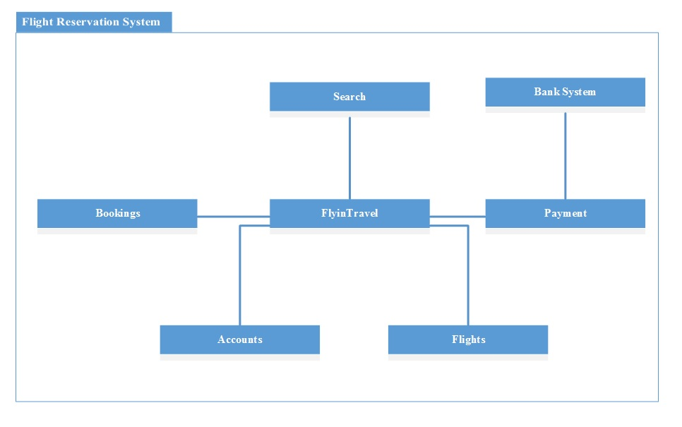
FlyinTravel

Slide 4
Overview
Use Case Diagram and Scenario
Class Diagram and OCL
State Machines and Action Specification
Working Prototype
Collaboration Tools used
Lessons Learned
FlyinTravel Demo

Slide 5
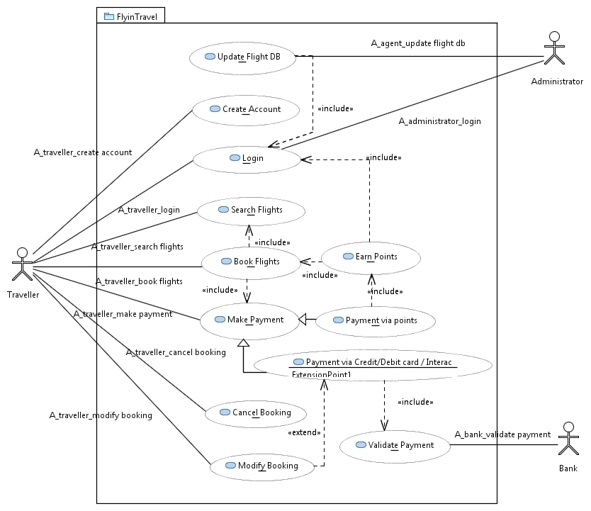
Use-Case Diagram

Slide 6
Fully Dressed Use-Case Scenario
Use case ID | UC-005
Name | Search Flights
Actor(s) | Traveler
Description | The Traveler search for the flight as per the Traveler’s requirements.
Precondition(s) | The Traveler should launch the system and be in the main page.
Basic Flow | 1. Traveler clicks search flights. 2. System displays the search flights with below search options One way or Round trip Domestic or International Source location Destination Location Date of travel No of Passengers Type of Passengers(Adult/kids) 3. Traveler enters all the options. 4. System retrieves the search results.
Post Condition(s) | Retrieved flights are displayed.
Exception(s) | Error Message is displayed if any of the mandatory information is not entered.

Slide 7
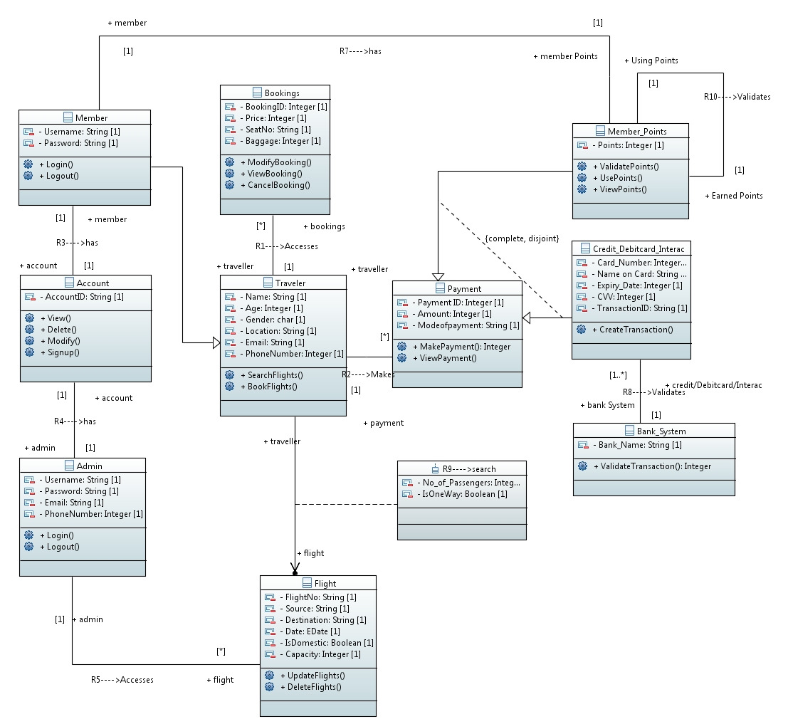
Class Diagram

Slide 8
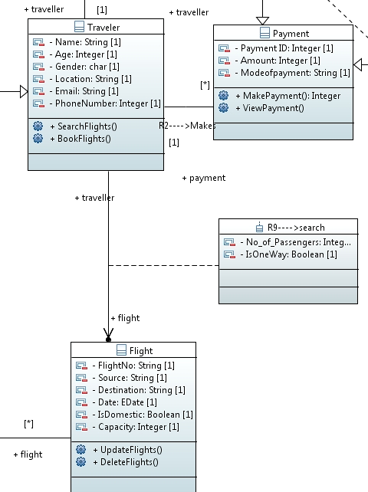
Traveler-Flight Classes

Slide 9

Member-Traveler Classes

Slide 10

Admin-Flight Classes

Slide 11

Payment Class

Slide 12
Object Constraint Language (OCL)
Calling Signup in the Class Account creates a Member Account in the system.
Calling Delete in the Class Account removes the Member Account in the system.
Booking IDs should be unique.
The minimum age of traveler should be 18

Slide 13
Object Constraint Language (OCL)
Context Account:: Signup(M)
pre: self.R3-> excludes(M)
post: self.R3-> includes(M)
Context Account:: Delete(M)
pre: self.R3-> includes(M)
post: self.R3-> excludes(M)
Context Bookings
inv: self.allInstances()->ForAll (C1,C2 | C1<>C2 implies
C1.BookingID<>C2.BookingID)
Context Traveler
inv: self.Age>=18

Slide 14
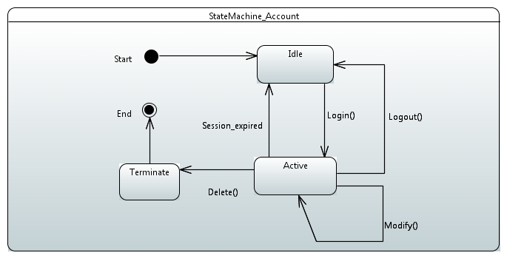
State Machine for Account Class

Slide 15
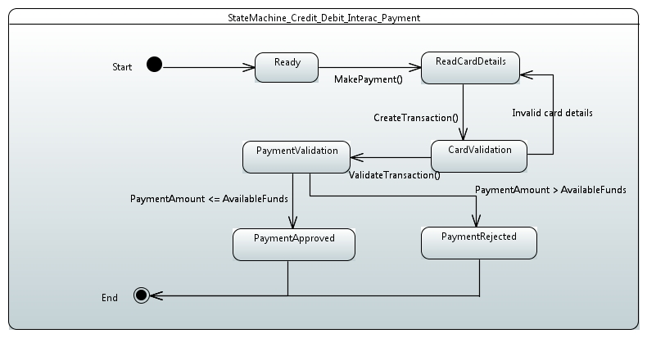
State Machine for Credit/Debit/Interac card Payment Class

Slide 16
Action Specification for View Booking operation
This Method performs below actions
Reads the Booking id.
Searches the Booking id in the booked database.
If Booking id found, retrieves the booking details like flight number, source, destination, and no of passengers and prints on screen.
public void viewbooking()
{
BookingDetails temp; //creating a temporary object of Booking details
System.out.print("\n =========== Please Enter the Booking ID: ");
BookingID = read.GetInt();
Static Vector fDetails = new vector (); // Flight booking database vector populated in other methods we are just using it here
System.out.println("---Flight No.---Flight Date---Flight Time---NO.Passengers---Source---Dest---"); // displaying flight schedule
System.out.println("");
for (int i = 0; i<fDetails.size();i++) // start of for loop
{
temp =(BookingDetails)fDetails.elementAt(i); // temporary variable
if(temp.Destination.equals(BookingID)) //start of if statement
{
System.out.println(temp.Flight_Num+"----"+temp.FlightDate+"----"+temp.Time+"----"+temp.Num_Of_Passengers+"----"+temp.Source+"----"+temp.Destination);
} // end of if statement
} // end of for loop
}

Slide 17
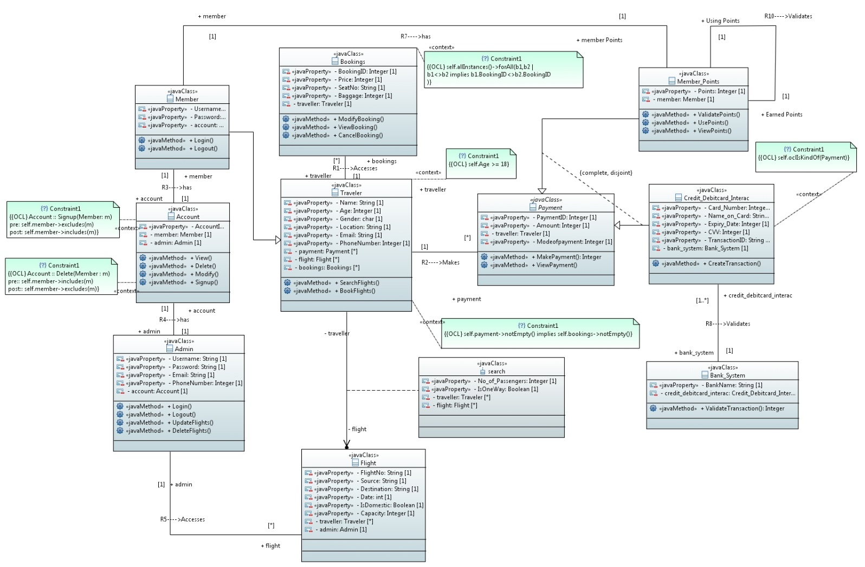
Executable
Class Diagram

Slide 18
}
/**
* Getter of admin
*/
public Admin getAdmin() {
return admin;
}
/**
* Setter of admin
*/
public void setAdmin(Admin admin) {
this.admin = admin;
}
/**
*
*/
public void View() {
// TODO Auto-generated method
}
/**
*
*/
public void Delete() {
// TODO Auto-generated method
}
/**
*
*/
public void Modify() {
// TODO Auto-generated method
}
/**
*
*/
public void Signup() {
// TODO Auto-generated method
}
}
public class Account {
/**
*
*/
private String AccountID;
/**
*
*/
private Member member;
/**
*
*/
private Admin admin;
/**
* Getter of AccountID
*/
public String getAccountID() {
return AccountID;
}
/**
* Setter of AccountID
*/
public void setAccountID(String AccountID) {
this.AccountID = AccountID;
}
/**
* Getter of member
*/
public Member getMember() {
return member;
}
/**
* Setter of member
*/
public void setMember(Member member) {
this.member = member;
Account.java

Slide 19
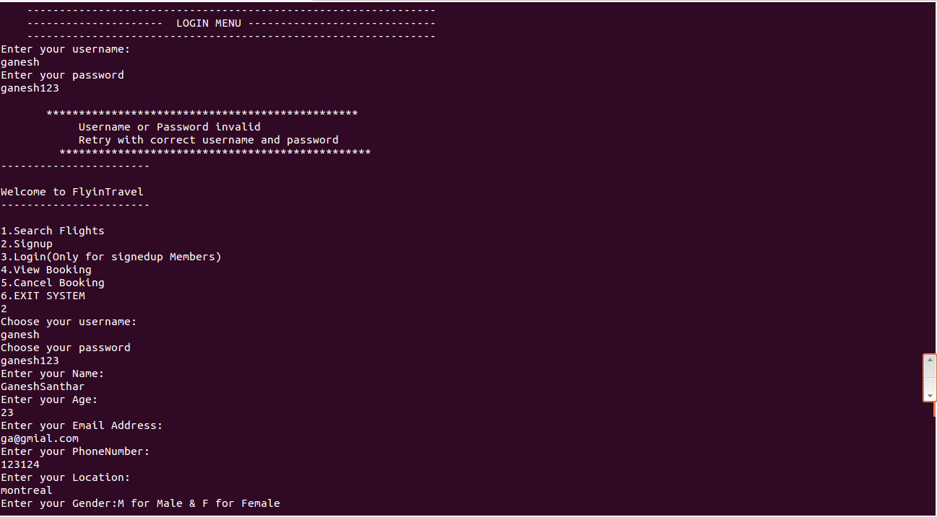
Working Prototype

Slide 20
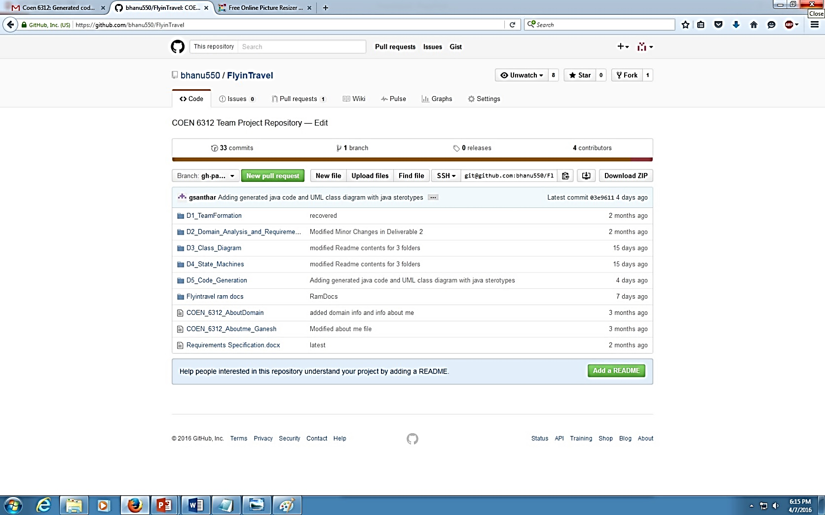
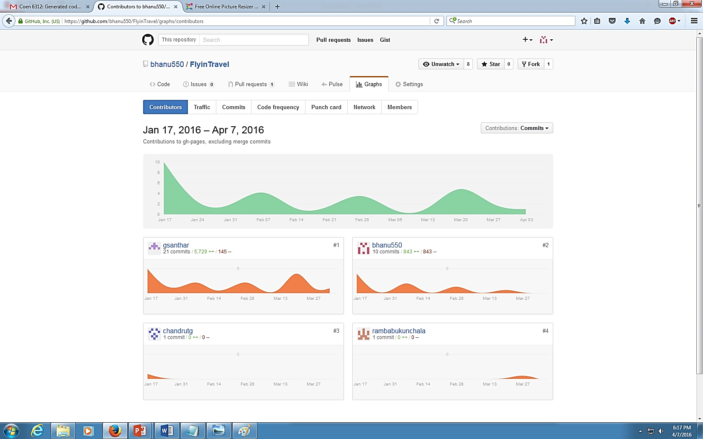
GitHub Online Repository

Slide 21
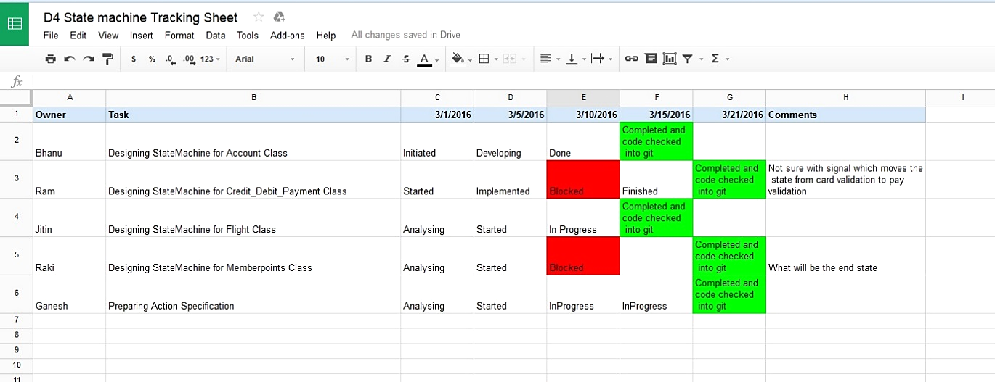
Google Sheets – Progress Tracking

Slide 22
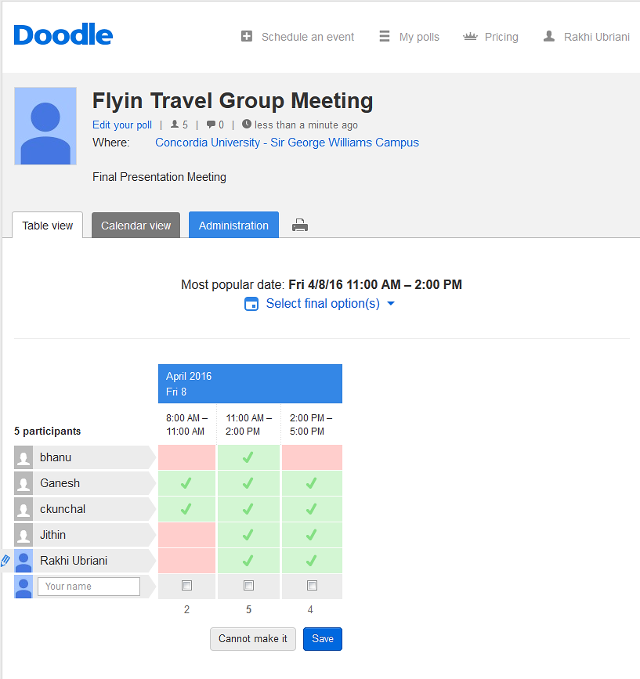
Doodle- Meeting Scheduling

Slide 23
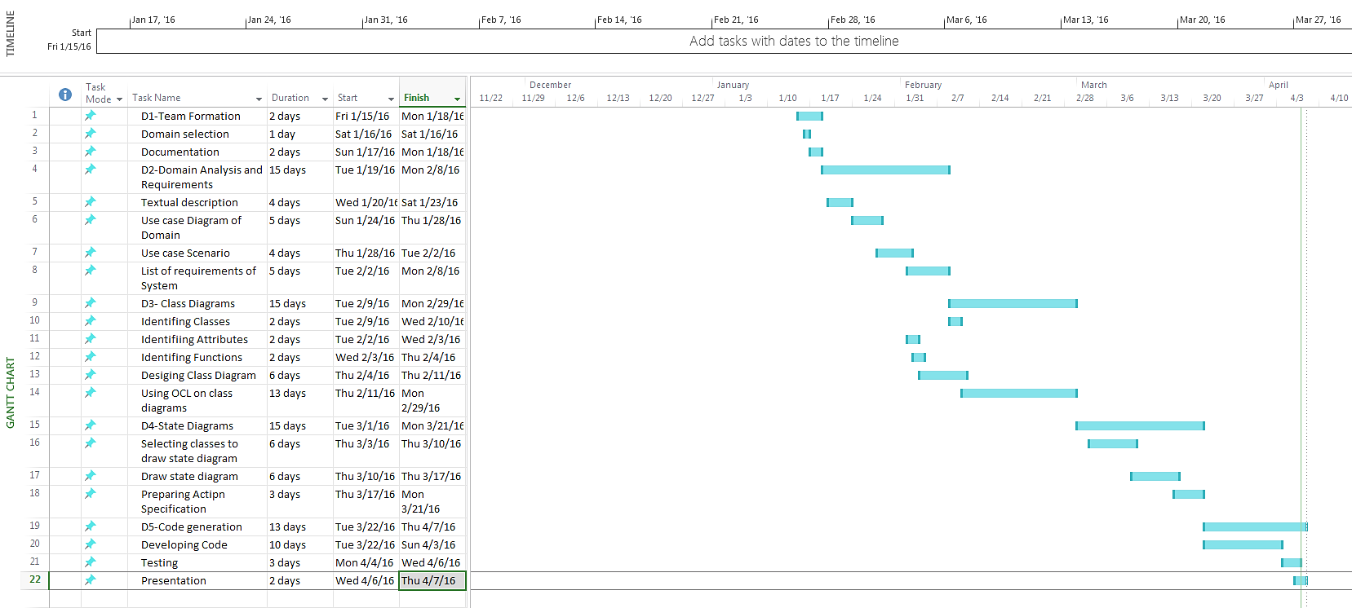
Microsoft Project – Gantt Chart

Slide 24
Lessons Learned
Model Driven Concepts
Papyrus tool
Team Spirit
Pressure Handling
Communication skills

Slide 25
Review
Introduced to Object Management Group (OMG)
Dealing with various Standard tools
Prepared for Current Market Situations
Need more number of workshops

Slide 26
Thank you
Any Questions?

